Slide 1
SENTINEL: INTELLIGENT MULTI CAMERA FACE DETECTION, RECOGNITION AND TRACKING SYSTEM
PIP104 PROFESSIONAL PRACTICE-II
VIVA-VOCE
Batch Number:CAI-G17
Roll Number | Student Name
Under the Supervision of,
Mr. SHEIK JAMIL AHMED
Assistant Professor
School of Computer Science Engineering & Information Science
Presidency University
20201CAI0128 RISHI RAGAV V
20201CAI0107 ISRAR AHMED
20201CAI0117 RAKSHITH MB
20201CAI0090 MD FAIZAN USMAN SAIT

Slide 2
Introduction
Video surveillance has evolved significantly, originating from rudimentary closed-circuit systems in the mid-20th century to becoming a cornerstone of modern security. Early closed-circuit television (CCTV) systems were basic, associated with banks and government facilities. The transition from analog to digital in the late 20th century marked a pivotal moment, offering higher resolution, increased storage, and remote monitoring capabilities. Digital systems integrated facial recognition and motion detection, enhancing versatility.
In the 21st century, HD and UHD cameras became standard, excelling in image clarity and low-light conditions. Artificial intelligence and machine learning introduced automated analysis, enabling real-time anomaly detection, face recognition, and object tracking. Video surveillance applications expanded from high-security environments to public safety, urban planning, transportation, retail, and residential security. It plays a pivotal role in crime prevention, investigation, and community protection in law enforcement and public safety. The continuous innovation in video surveillance technology reflects its crucial role in capturing and analyzing visual data for diverse applications.

Slide 3
Literature Review
Reis, D., Kupec, J., Hong, J., & Daoudi, A. (2023). "Real-Time Flying Object Detection with YOLOv8.” This paper addresses the crucial challenge of real-time flying object detection, emphasizing the increasing threat posed by drones in various scenarios, including security and surveillance. The authors introduce a generalized model for detecting flying objects and a refined model suitable for real-world implementation. Leveraging transfer learning and the YOLOv8 single-shot detector, the study encompasses a comprehensive analysis of the architecture and functionality of YOLOv8. With a focus on the challenges associated with flying objects, the paper explores variances in spatial sizes, aspect ratios, and inference speed. The proposed models exhibit promising results, with the refined model achieving an improved mean average precision (mAP50-95) of 0.835 at an impressive inference speed. The significance of visual detection in countering the stealth capabilities of drones is emphasized, urging the integration of reliable detection technology.
Arbués-Sangüesa, A., Haro, G., & Ballester, C. (2019). Multi-Person tracking by multi-scale detection in Basketball scenarios. The objective is to present a machine learning approach for visual object detection that is fast and accurate. The approach is demonstrated on the task of face detection. A new image representation that allows for very fast feature evaluation. The features are like Haar basis functions and can be computed at any scale or location in constant time. AdaBoost is a learning algorithm that selects a small number of critical features from a large set and yields efficient classifiers. The features are chosen by minimizing a weighted error function. Cascade of Classifiers is defined as method for combining increasingly more complex classifiers in a cascade structure that discards non-face regions quickly while spending more computation on promising regions4. The cascade provides statistical guarantees that discarded regions are unlikely to contain faces. Results of the face detection system achieves high detection rates and low false positive rates on a difficult dataset. It can process images extremely rapidly (15 frames per second) without using any auxiliary information. It is also robust to various conditions such as illumination, scale, pose, and camera variation.

Slide 4
Research Gaps Identified
The research gaps in the current methods:
Scalability and Computational Complexity
Dependency on Exemplar-Based Learning
Generalizability Across Diverse Surveillance Scenarios
Real-Time Data Processing
Environmental Factors
Multi-Camera Capabilities

Slide 5
Proposed Methodology
It was found that computer vision is a data heavy and computationally expensive process that requires a powerful system and high quality as well extensive dataset. Hence models were trained in the server side so that the user can focus on other parts of their project. The application of edge computing where the use of training data locally on the device itself has become popular. To facilitate this process, there have been improvements made in computer vision and machine learning algorithms. One such example is YOLOv8 whose highlighting features are transferring learning, improved loss function and improved speed for data crunching of large datasets.
YOLOv8 is a state-of-the-art object detection algorithm that uses a single convolutional neural network to predict bounding boxes and class probabilities for multiple objects in an image. YOLOv8 is faster and more accurate than previous versions of YOLO, and it also supports other tasks such as segmentation, classification, and pose estimation.

Slide 6
Objectives
1. Enhanced Face Detection: Develop a highly accurate face detection algorithm that can efficiently identify and locate faces in real-time, regardless of variations in lighting conditions, angles, and facial expressions.
2. Robust Face Recognition: Create a robust face recognition system that can match detected faces to a pre-defined database of individuals, allowing for the positive identification of persons of interest and generating alerts as necessary.
3. Multi-Camera Integration: Implement the capability to seamlessly integrate with multiple cameras across a surveillance network, enabling simultaneous monitoring and tracking of individuals across different camera views.
4. Real-Time Tracking: Develop an intelligent tracking system that can monitor and track recognized faces as they move within the camera network, providing real-time information on their whereabouts and activities.
5. Alert and Reporting System: Design a comprehensive alert and reporting system that can automatically generate alerts for suspicious activities, unauthorized access, or individuals on watchlists, and provide detailed reports for post-incident analysis and evidence gathering.

Slide 7
System Design & Implementation
Start State:
Create/Update dataset
Train the model on the dataset
Apply machine learning and deep learning techniques for face detection
Use the current data and refine the model until satisfactory result is achieved.
End State:
Apply Evaluation methods and check for accuracy and other pertinent factors
Continuously track the person and generate real time data
Apply machine learning and deep learning techniques for face recognition
Fig 1. Architecture of the System

Slide 8
System Design & Implementation
Implementation is the stage in a project where the ideas and plans are turned into reality. It’s the phase, where all the tasks and activities outlined in the project plan are carried out. This phase also includes monitoring the project’s progress to ensure it stays on track and any issues are addressed promptly. The success of the project largely depends on how well this phase is executed. It’s the bridge between the planning and the final outcome, and it’s where the project manager takes control, guiding the team towards the project goals.
The implementation is the stage in the software development process where the software is coded, tested, and deployed. Some of the tasks involved in this phase are:
Dataset Creation: Dataset creation is the process of collecting, organizing, and labeling data for a specific purpose, such as machine learning, data analysis, or visualization.
Coding: This is the task of writing the source code of the software using a programming language such as Python. The code should follow the design specifications and coding standards of the project. The code should also be well-documented and commented for readability and maintainability.
Testing: This is the task of verifying and validating the functionality, performance, and quality of the software. Testing can be done at different levels, such as unit testing, integration testing, system testing, and acceptance testing. Testing can also involve various techniques, such as black-box testing, white-box testing, regression testing, and stress testing. Testing should aim to find and fix any errors, bugs, or defects in the software before deployment.
Deployment: This is the task of installing and launching the software in the target environment, such as a server, a device, or a cloud platform. Deployment can also involve configuration, customization, and optimization of the software according to the user’s needs and preferences. Deployment should ensure that the software is accessible, usable, and secure for the end-users.

Slide 9
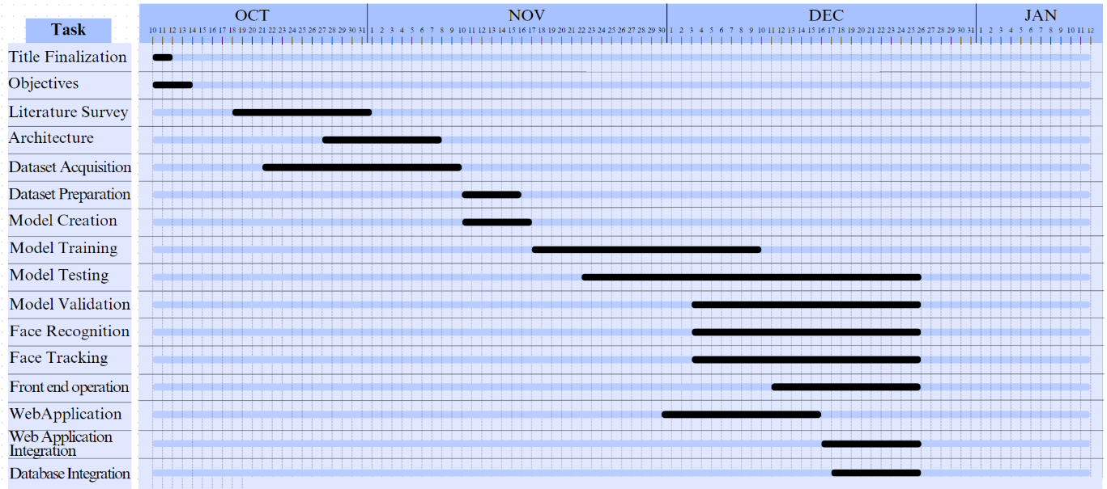
Timeline of Project
Fig. Gantt Chart

Slide 10
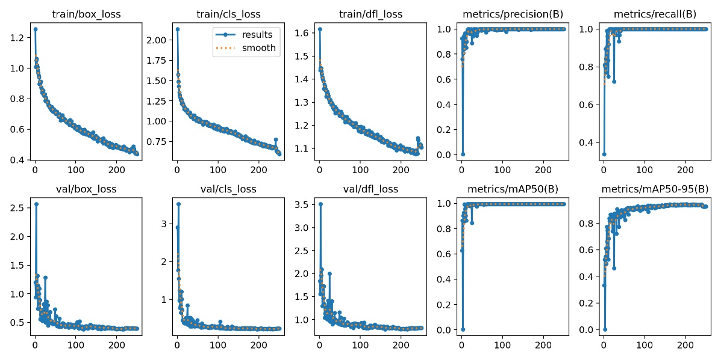
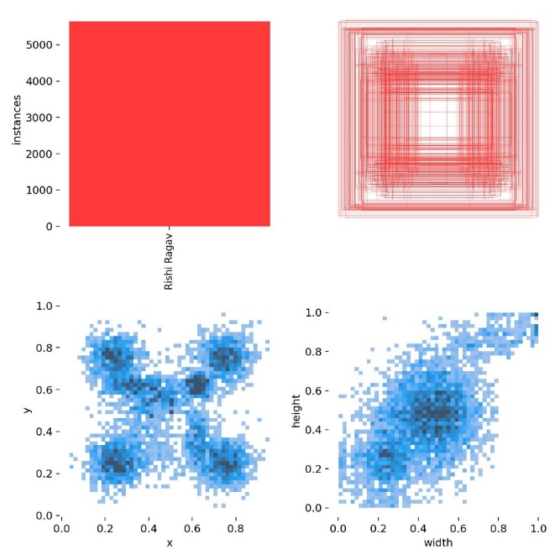
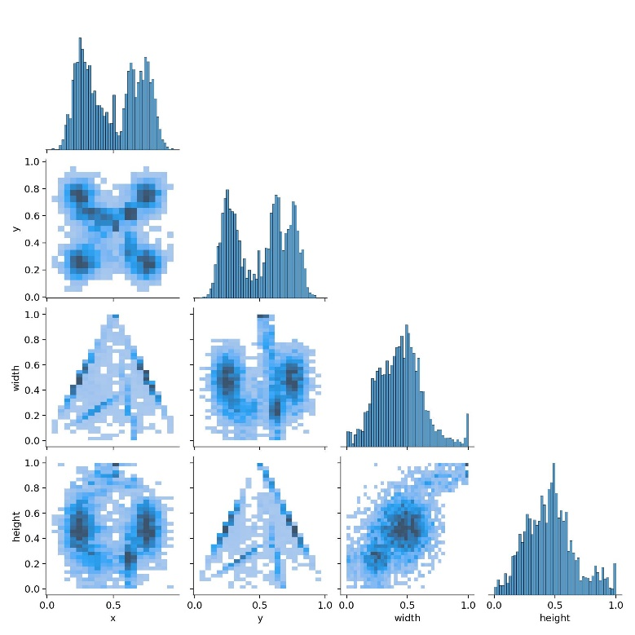
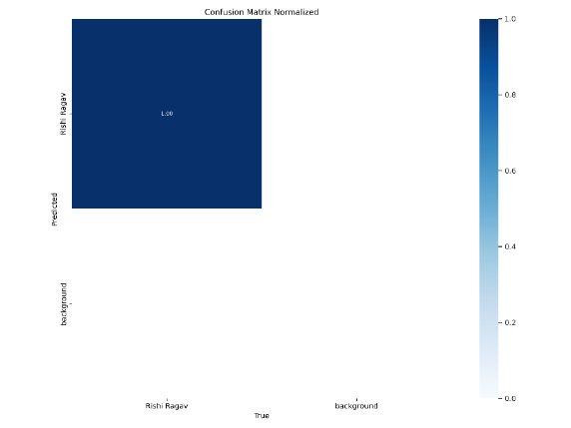
Outcomes / Results Obtained
Fig. Results of the model
Fig. Labels
Fig. labels Correlogram
Fig 9.4 Normalized Confusion Matrix

Slide 11
Conclusion
In the conclusion we can summarize the development and implementation of the Sentinel system. We would highlight how it has achieved face detection, recognition and tracking capabilities. Additionally, we would mention its integration, with a database that enables identification of known individuals.
The conclusion will underscore the significant progress represented by the Sentinel system in video surveillance capabilities. We will emphasize how it incorporates computer vision and deep learning models well as intelligent tracking algorithms to enhance its effectiveness.
In the conclusion we will explore the sectors where the Sentinel system can find applications. These sectors include safety, law enforcement and critical infrastructure protection. We will emphasize that this system can significantly contribute to strengthening security measures and improving surveillance operations in these areas

Slide 12
References
[1] Probabilistic recognition of human faces from video by q Shaohua Zhou,* Volker Krueger, and Rama Chellappa
[2] Liu, Z., Luo, D., Wang, Y., Wang, L., Tai, Y., Wang, C., Li, J., Huang, F., & Lu, T. (2020). TEINet: Towards an Efficient Architecture for Video Recognition.
3] Mohana and Dr. H. V. Ravish Aradhya. Design and Implementation of Object Detection, Tracking, Counting and Classification Algorithms using Artificial Intelligence for Automated Video Surveillance Applications
[4] Dhaya, R. CCTV Surveillance for Unprecedented Violence and Traffic Monitoring.
[5] Davies, A. C., & Velastin, S. A. (2005). A Progress Review of Intelligent CCTV Surveillance Systems.
[6] Reis, D., Kupec, J., Hong, J., & Daoudi, A. (2023). "Real-Time Flying Object Detection with YOLOv8.”
[7] Thaler, M., & Bailer, W. (2013). Real-time person detection and tracking in panoramic video.
[8] Arbués-Sangüesa, A., Haro, G., & Ballester, C. (2019). Multi-Person tracking by multi-scale detection in Basketball scenarios
[9] Paul Viola and Michael Jones,Rapid Object Detection using a Boosted Cascade of Simple Features.
[10] Oluwatoyin P. Popoola and Kejun Wang Video-Based Abnormal Human Behavior
Recognition—A Review

Slide 13
Publication Details
The Publication for chosen this project is “INTERNATIONAL JOURNAL OF CREATIVE RESEARCH THOUGHTS – IJCRT”.
A peer-reviewed, open-access publication with an impact factor of 7.97 is the International Journal of Creative Research Thoughts (IJCRT). It was founded in 2013 and releases academic open access journals every month. Because the IJCRT is multidisciplinary, it encompasses a broad spectrum of academic fields.
Publication link: https://ijcrt.org/viewfulltext.php?&p_id=IJCRT2401210

Slide 14

Thank You

